Slide 1

Data Science R Squared
Facultad de Ciencias Económicas
Catedrático: Franz Haidacher

Slide 2
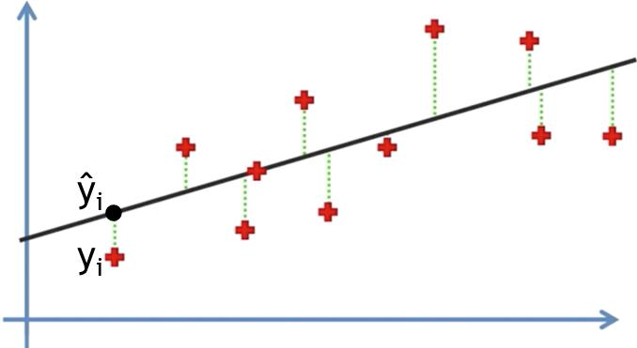
Residual Sum of Squares
SS_{res} = SUM (y_{i} – ŷ_{i})²

Slide 3
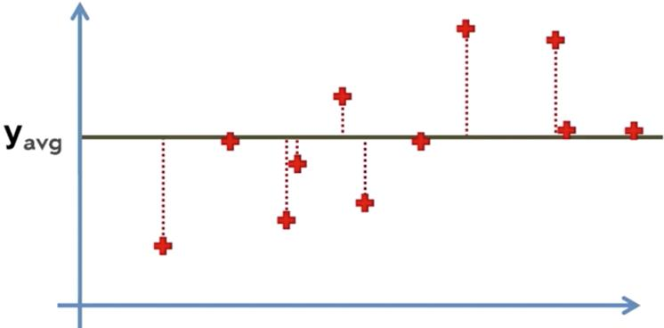
Total Sum of Squares
SS_{tot} = SUM (y_{i} – y_{avg})²

Slide 4
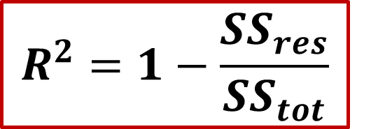
R² = Coefficient of Determination
SS_{res} = SUM (y_{i} – ŷ_{i})²
SS_{tot} = SUM (y_{i} – y_{avg})²
$$R^{2}=1−\frac{{SS}_{res}}{{SS}_{tot}}$$
SS_{res} should be minimized
SS_{tot} remains constant
=> R² should be as close as possible to 1

Slide 5

Adjusted R Squared
y = b₀ + b₁*x₁
Purpose: to penalize for inserting a variable that does not help the model
y = b₀ + b₁*x₁ + b₂*x₂
y = b₀ + b₁*x₁ + b₂*x₂ + b₃*x₃
R2 will never decrease if we add an additional predictor variable to the model. We will not know if this helps to gain accuracy or not.
$$R^{2}=1−\frac{{SS}_{res}}{{SS}_{tot}}$$
$${Adj R}^{2}=1−(1−R^{2})\frac{n−1}{n−p−1}$$
p: number of regressors
n: sample size

Slide 6
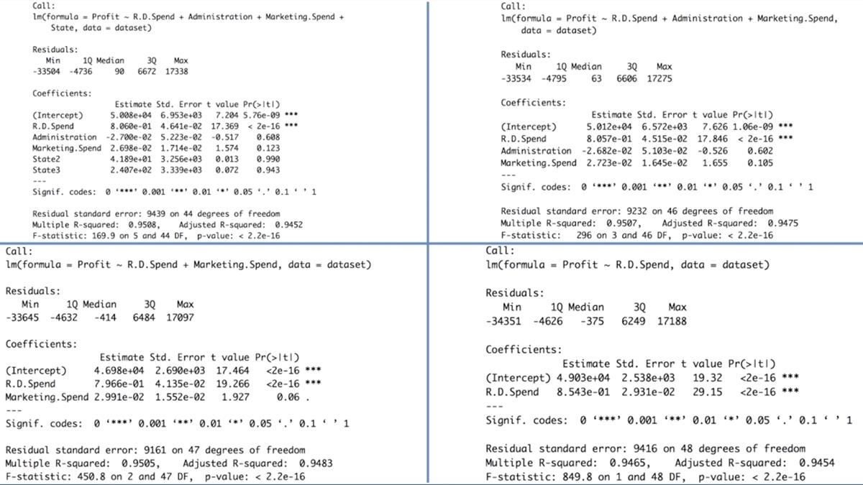
Summary(regressor)

Slide 7
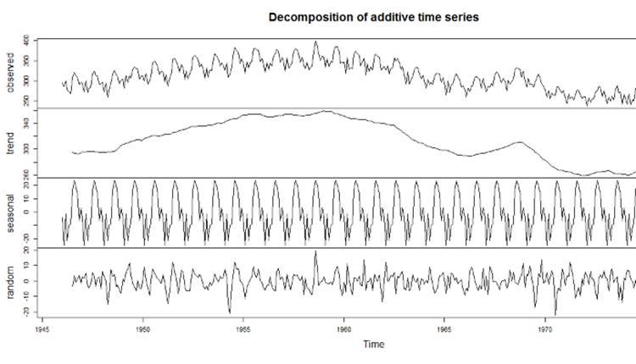
Time Series Decomposition

